Slide 1
Topic & persona
Topic: Home
Persona: Alex

Slide 2
Define
POV Alex needs more sleep because she’s always tired
Alex needs peace of mind because she feels nervous about her kid’s well-being when she’s not around
Alex needs more shared interests with her husband because she wants to do more things together
How might we
How might we convince Alex to get more quality sleep?
How might we make getting a good sleep schedule something, which Alex aspires towards?
How might we make Alex more relaxed when her kids are not around?
How might we make Alex less nervous?
How might we make Alex and her husband do more things together?
How might we find more shared Interests between Alex and her husband?

Slide 3
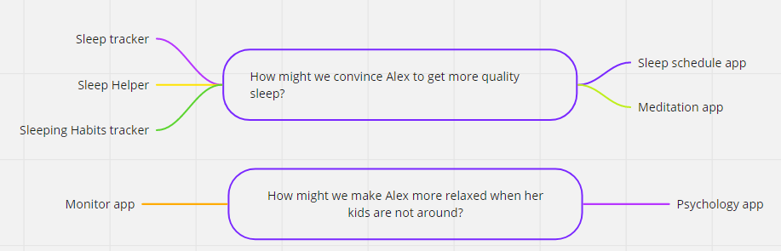
Ideation

Slide 4
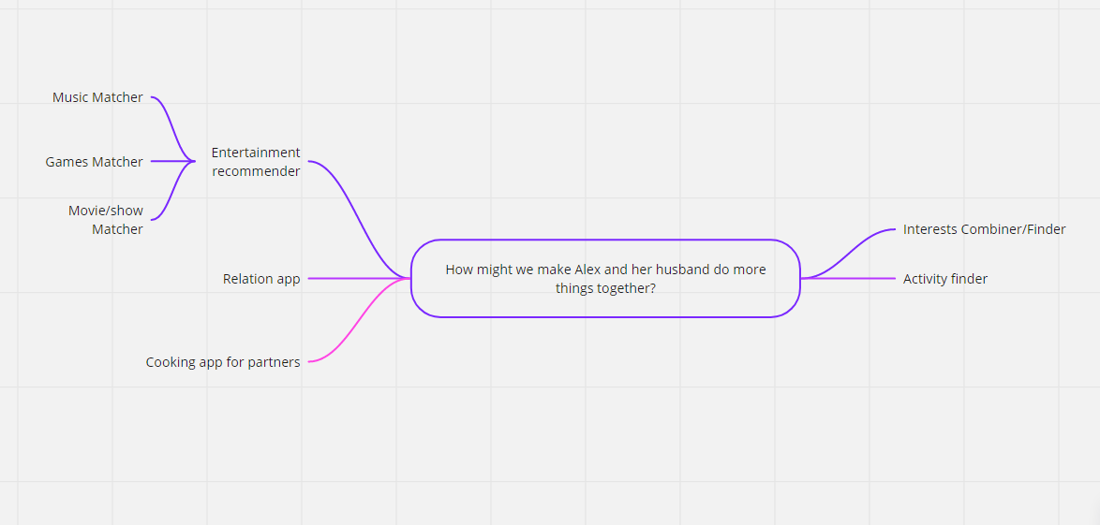

Slide 5
Prototyping
idee: Movie/Serie matcher
MosCoW:
Must
User must be able to register/login/logout
User must be able to create a group
User must be able to invite another person to a group
User must be able to join a group
User must be able to view a list of recommended movies in a group
User must be able to view previously matched movies/series
User must be able to rate a matched movie
Should
User must be able to indicate if they have already watched a movie/serie
User must be able to choose if they want to watch a movie/serie or not User must be able to filter a feed User must be able to put a movie/serie on a watchlist (gets priority in matching)
User must be able to update their profile
User must be able to search for a specific movie/serie
User must be able to change the view of recommendations
User must be able to edit a group
Could
User must be able to receive notifications when they have a movie/serie match
User must be able to view the details of a movie
Wont
User must be able to create/join a public group

Slide 6
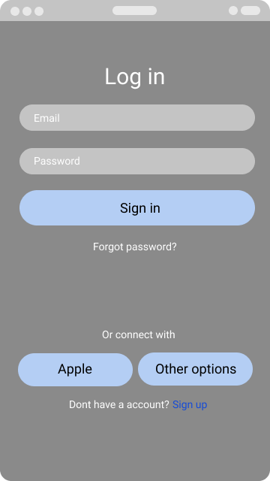
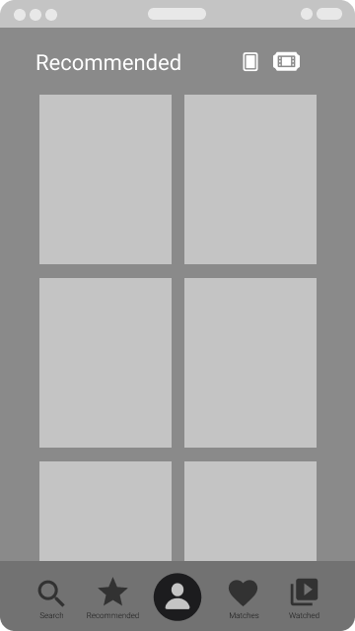
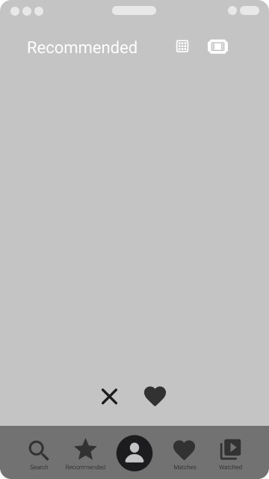
WireFrames

Slide 7
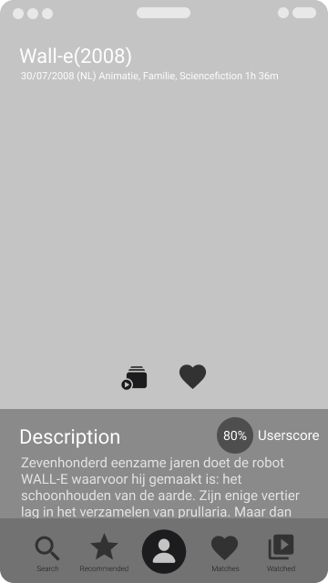
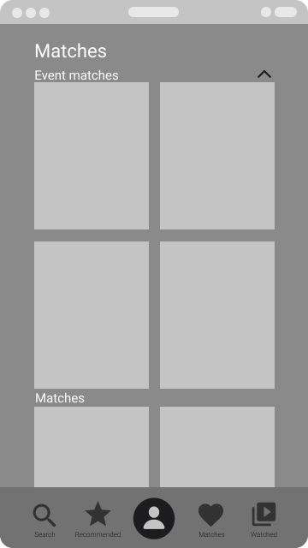
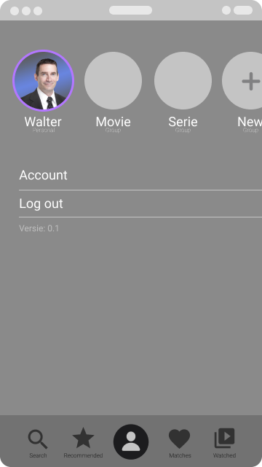

Slide 8
